Slide 1
AgentScore Weekly Update
Week of November 9, 2026
Status: At Risk. Beta Cohorts and External Interest as of Nov 10, 2026

Slide 2
This week in four answers
Status: At Risk. Only one customer has used AgentScore, so feedback is thin
WHO IS USING IT
WHAT IS STOPPING ONBOARDING
FEEDBACK FROM PEOPLE USING IT
WHAT IS NEXT
1 customer live, 1 internal agent scoring
Tritusa is live and using the product. Wolters Kluwer logged in, nothing run yet.
Tosca agent (ATA) is scoring. Performance Agent, Quality Agent and the chatbot are in progress.
13 companies demoed.
Few replies, and on-prem
Under 12% of interested leads reached a demo. 94 emailed companies have not replied.
On-prem: 4 of 13 demos required it, and 5 companies have asked.
Group scoring blocks 5 accounts.
Users ask what comes after the score
Tritusa scored well and asked "now what?" Feedback session is Tuesday night.
Top asks: simulation testing (6 accounts) and scoring a group of agents (5).
Get every user to a first score
Wednesday: update this deck with Tritusa feedback.
Early-adopter email to smaller tech, telco and e-commerce companies.
Steering committee pitch, week of Nov 16.
Sources: Beta Cohorts and External Interest (Nov 10), Customer Feedback Log, Lost Lead Analysis (Nov 10), Nov 6 status review.

Slide 3
Where each account stands and what blocks it
Accounts grouped by what is stopping them. As of Nov 10
Where they are | Accounts | What happened
Using it | Tritusa | Live since Oct 22. Agents scored well, then asked "now what?" Wants help with how scores are built, guardrails (none yet), finding failures, best practices and reports. Expected run frequency: not set. Actual: not measured yet.
Using it, nothing run | Wolters Kluwer | Signed in Nov 4, has not run anything. Needs group scoring. AI Workspace traces wait on a legal opt-in.
Could not onboard: no on-prem | Accenture, PG&E, Oracle, Meta, Love's, Eaton | 4 of 13 demos required on-prem (Love's, Meta, Eaton, Accenture). Accenture and Meta want their own AWS. PG&E and Oracle want their own cloud. Love's said it can't do much without it. Eaton was not settled.
Blocked: no group scoring | Wolters Kluwer, Meta, Aptiv, Eaton, Accenture | 5 accounts want to score a group of agents or a workflow. Not available yet.
Blocked: other missing pieces | Meta, Eaton, L'Oréal, Merito | Meta: simulation testing. Eaton: CI/CD gate and a written data-handling answer. L'Oréal: AI Workspace legal opt-in. Merito: partner-access answer.
Invited, no sign-in | Merito, L'Oréal, Aptiv, New Vision, Eaton, BearingPoint, Workday | 7 of 9 invited. No reply after follow-up.
Internal: Tosca agent (ATA) is scoring. Performance Agent, Quality Agent, the chatbot and Smith are not.
Sources: Beta Cohorts (Nov 4), Customer Feedback Log, Nov 6 status review, Nov 10 working session.

Slide 4
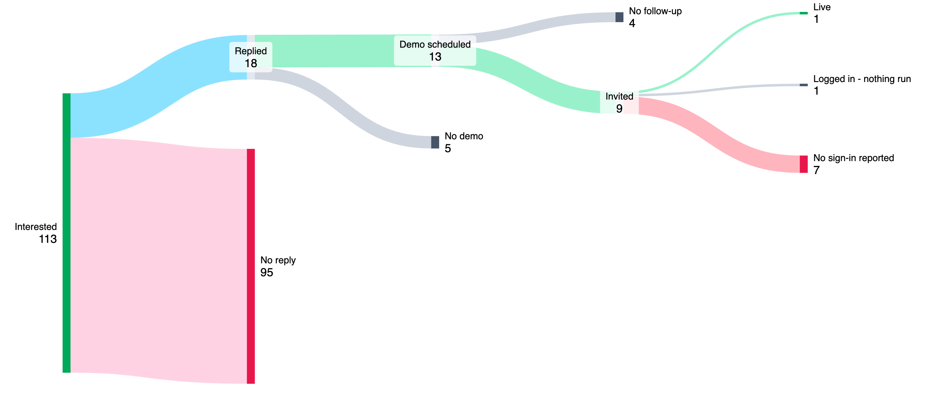
Under 12% of interested leads reached a demo
94
emailed, no reply. 28 never got a follow-up.
24 of 167
submissions are junk (14%): 12 internal, 12 repeat or accidental.
4 of 13
demos required on-prem. 5 companies have asked, 3 of them this week.
113 interested companies, as of Nov 10. 13 reached a scheduled demo (11.5%). The 113 is already a filtered list.
What to do before adding more leads
Adding leads without understanding the 90% loss would lose them too. Replies came fast when they came: 9 of 14 within 8 days. The leak is the 30 to 35 day wait for a follow-up, and nobody has had a second one.
On-prem is now asked before a demo, so those leads stop at "no demo".
6 days
median days from first email to reply. Range 1 to 35, 14 companies.
Sources: Lost Lead Analysis (Nov 10, section 3 has reply time per company), Beta Cohorts (Nov 4), Nov 6 status review.

Slide 5
Of 113 interested, 18 replied, 13 got a demo and 2 signed in
Average from signup to... | Avg days | Median | Companies
First email | 1.5 | 0 | 92
First reply | 14.6 | 7 | 14
Demo | 25 | 18 | 7
Beta invite | 47 | 51 | 8
First sign-in | 72 | 72 | 1
Email is fast. Everything after it is slow.
Replies took a median 7 days from signup. Four waited 35 to 39 days, until the Sep 24 follow-up.
Demo uses the 7 companies with a recorded date. First sign-in is Tritusa only, by the date use was reported (59 days by Oct 22 support mail).
Percent of the 113 interested companies, as of Nov 10. Days counted from Labs form signup. Sources: Lost Lead Analysis (Nov 10), Beta Cohorts (Nov 4), External Interest.

Slide 6
Signups: about 1 a day outside the three Transform events
The Transform invites are used up
140 dated Labs form submissions. 77 (55%) came on the three event days.
The other 63 came over 70 days: 0.9 a day. With event days it is 1.9. Without Transform invites, inbound averages under one lead a day.
Next: early-adopter email
Sent through Ryan, with the sign-up link. Target: smaller end of the customer base in technology, telco and e-commerce. Avoid government, regulated industries and healthcare.
Labs form submissions per day (people, not companies), Aug 19 - Oct 30. Dashed line: average outside event days, 0.9 a day.

Slide 7
What is next
No dates yet. Milestones and the evidence needed to move
THIS WEEK
EARLY ADOPTERS
STEERING COMMITTEE
ROADMAP, NOW
Tuesday: Tritusa feedback session
Wednesday: update this deck with Tritusa feedback and the lost-lead pass.
Document on-prem demand with a count.
Chart adoption and response rates.
Target a smaller ICP
Andrew sends David the email draft. David takes it to Ryan.
Optional internal webinar. Framed as a lab that may go away.
Week of Nov 16
Lightweight pitch, about half an hour, for an executive group.
Show cohort status and evidence needed, not dates.
Release target: when customers love it, plus about a month and a half to harden, package and price.
Simpler onboarding
Every screen offers one next action until a user reads a score and a verdict.
Every internal Tricentis agent scoring.
Spike: JEV / decision models and simulation testing.
Sources: Nov 6 status review, Roadmap (Nov 4 draft), Nov 10 working session.

